Slide 1
Update on Balancing Platforms
July 3rd, 2025
MESC

Slide 2
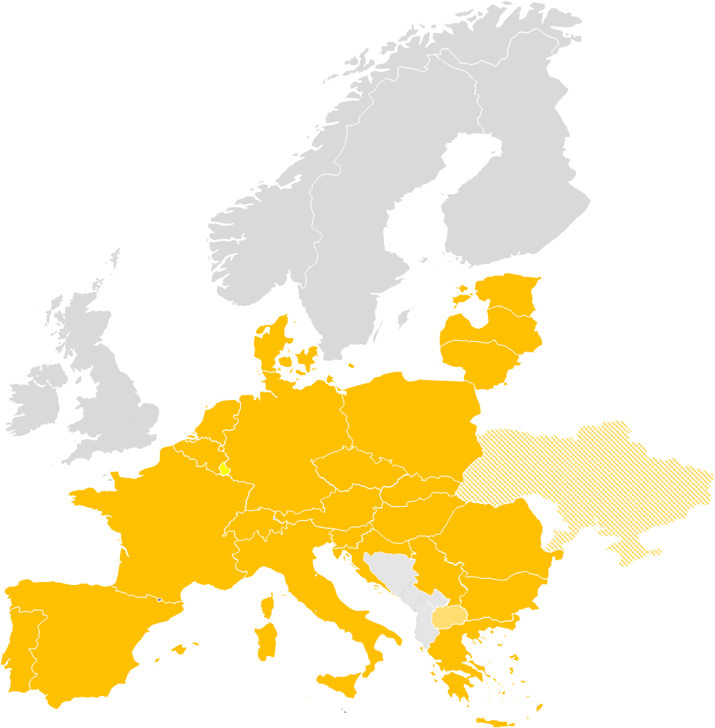
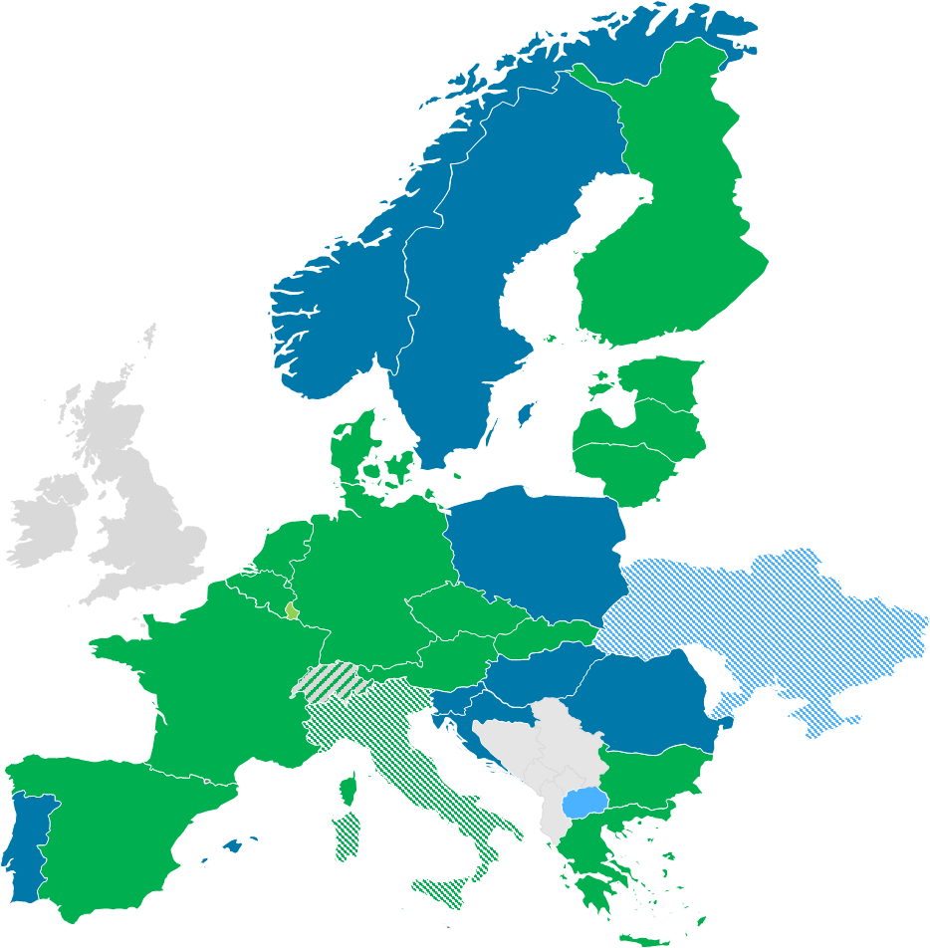
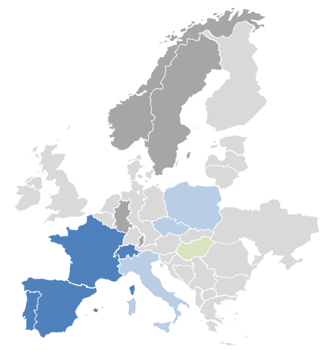
Introduction
Overview on current status of European Balancing Platforms
 | IGCC | MARI | PICASSO | TERRE
Balancing service | IN | mFRR | aFRR | RR
Participants
Target area | Continental Europe | ≥ Continental Europe | ≥ Continental Europe | ≥ RR TSOs
Go-live | 24/06/2021 & operational since 01/10/2011 | 05/10/2022* | 22/06/2022* | 29/09/2020*
Status
Highlights | Economic surplus of around 175 Mio. € in Q1 2025 | Economic surplus of 41 Mio. € in Q1/Q2 2025. | Economic surplus of more than 145 Mio € in Q1/Q2 2025. | Economic surplus of nearly 201 Mio. € in 2025.
* Date as of when cross-border exchanges were possible due to neighboring TSO joining. Technical go-live of platform was earlier.
European market design has significantly changed the local procurement rules.
In 2024 all platforms together achieved an economic surplus of more than 1,450 Mio. €

Slide 3
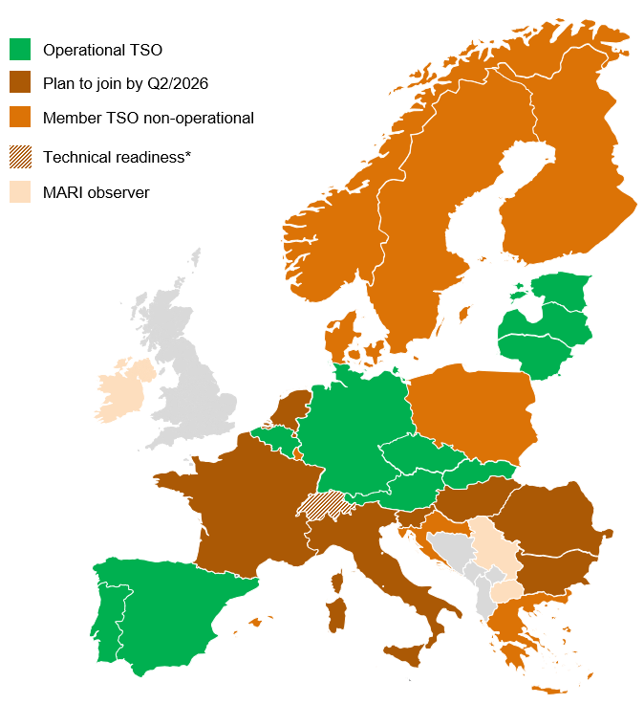
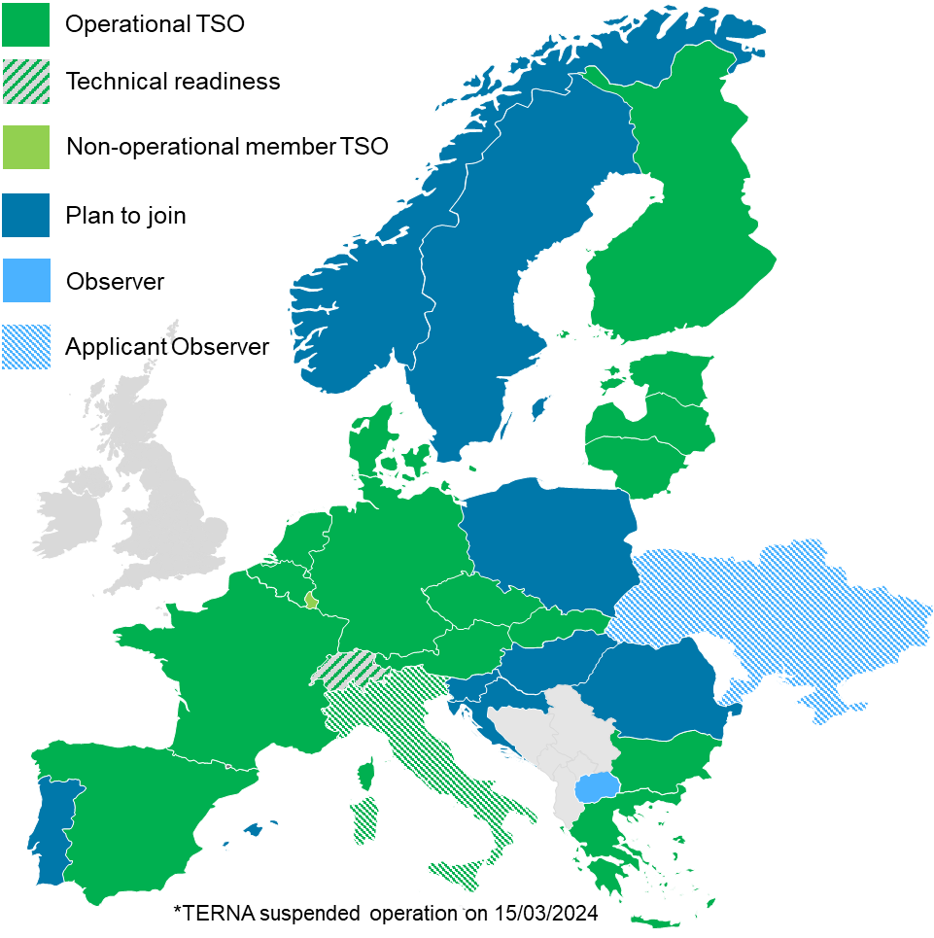
Recent developments and updates
Updates
Go-live at MARI since November 2024
November
Portuguese REN (Link to communication)
December
Slovakian SEPS (Link to communication)
Spanish RE (Link to communication)
May 2025
Elia (Link to communication)
Go-live at PICASSO since November 2024
November 24
SEPS joined PICASSO (Link to communication)
ELIA joined PICASSO (Link to communication)
February/March 25
ESO joined PICASSO (Link to communication)
Litgrid joined PICASSO (Link to communication)
ADMIE joined PICASSO (Link to communication)
Fingrid joined PICASSO (Link to communication)
April/May/June 25
RTE joined PICASSO (Link to communication)
AST joined PICASSO (Link to communication)
ELERING joined PICASSO (Link to communication)
RE joined PICASSO (Link to Communication)

Slide 4
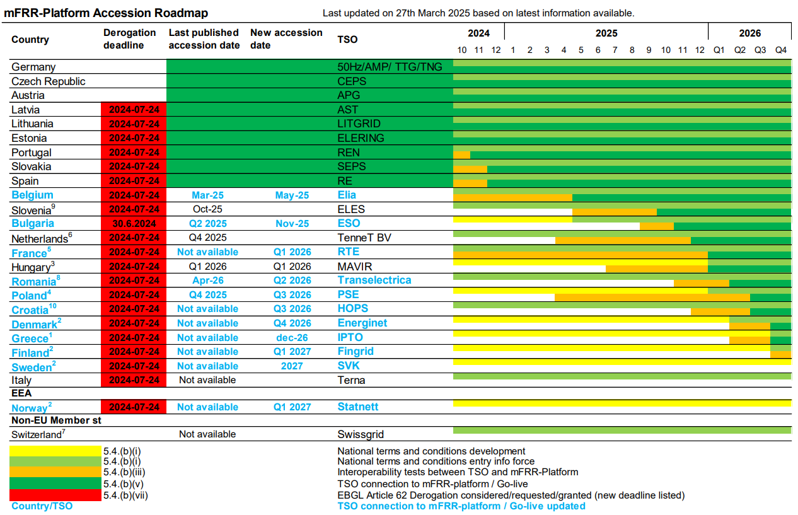
Recent developments and updates
Update of the accession roadmaps MARI
Background: Accession Roadmap based on 27.3. 2025 published version
MARI_Accession_Roadmap_APR_2025.pdf

Slide 5
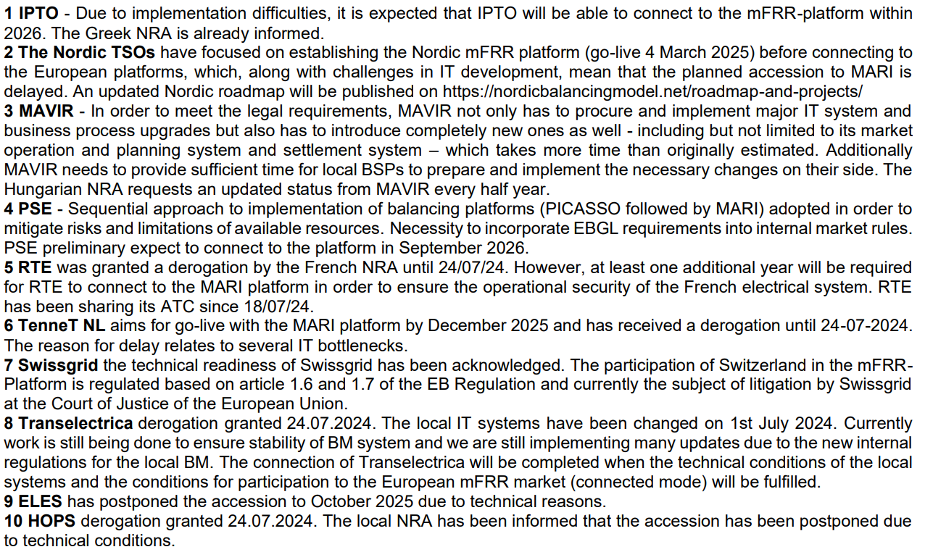
Recent developments and updates
Update of the accession roadmaps MARI
Background: Accession Roadmap based on 27.3. 2025 published version / footnotes MARI_Accession_Roadmap_APR_2025.pdf

Slide 6
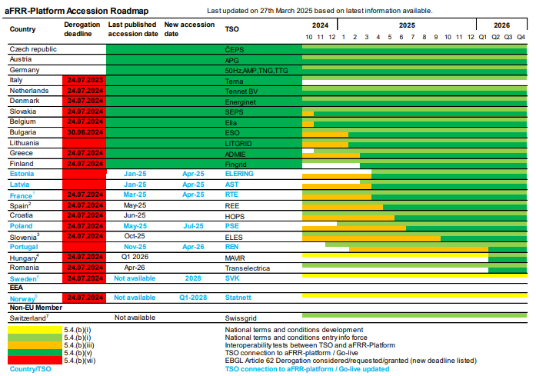
Recent developments and updates
Update of the accession roadmaps PICASSO
Background: Accession Roadmap based on 27.3. published version PICASSO_Accession_Roadmap_APR_2025.pdf

Slide 7
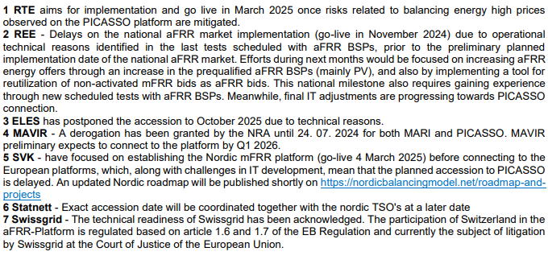
Recent developments and updates
Update of the accession roadmaps PICASSO
Background: Accession Roadmap based on 27.3. published version footnotes PICASSO_Accession_Roadmap_APR_2025.pdf

